Slide 1


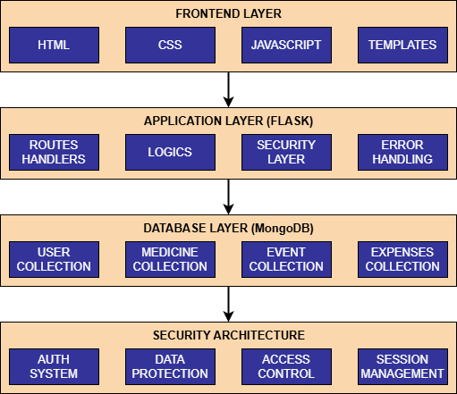
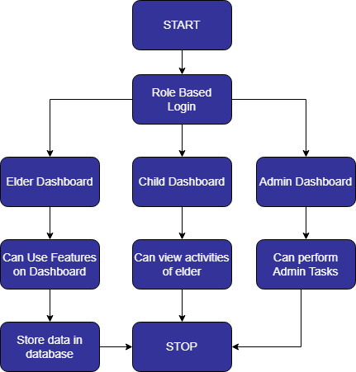



AgeWell: A Smart Portal for Senior Citizen Support
Rakshit Gupta Anjana Sharma
Email : guptarakshit9858@gmail.com
Phone : +919086304908
Email : anjana.sh224@gmail.com
Phone : +918494012776
Abstract
Architecture Diagram
AgeWell – A Smart Portal for Senior Citizen Support is an innovative web platform designed to assist elderly users in managing their daily routines independently while fostering stronger family connections. The system provides a user-friendly interface with essential features like medicine reminders, financial tracking, personal task scheduling, and social event participation. Additionally, the Learning Corner offers digital literacy resources, including step-by-step guides and a tips section for health and technology awareness. A dedicated child panel enables family members to monitor the well-being of their elderly relatives, while the admin dashboard manages content, user feedback, and tutorials. AgeWell bridges the digital divide by simplifying technology for elderly users, empowering them with tools to manage their health, finances, and social lives while promoting confidence and digital inclusion. The project integrates technology with care, fostering independence, and enhancing the quality of life for elderly users and their families.
Innovation & Impact
INNOVATION:
Combines health, finance, learning, and reminders in one easy-to-use platform. Provides daily health and tech tips tailored for elderly users.
IMPACT:
Empowers elderly users with digital tools for independent living.
Enhances family support through child panels and connected features.
Results/Outcomes
Methodology
Fully functional web portal developed.
Responsive design tested across devices.
Real-time dashboard data updates.
Enhanced usability for non-tech users.
Positive internal feedback from test users.
All modules implemented as planned.
User-Centric Design
Multi-role system (Elder, Child, Admin)
Intuitive interface for elderly users
Family integration system
Core Features
Medicine Management & Reminders
Financial Tracking & Budgeting
Social Events & Community Engagement
Emergency Support System
Technical Implementation
Python Flask Backend
MongoDB Database
Secure Authentication
Real-time Updates
.
Workflow
Language(s) | Technology Stack
LANGUAGES:
PYTHON
TECHNOLOGY STACK:
Frontend:
HTML5, CSS3, Bootstrap 5
JavaScript, Jinja2 templates
Backend:
Flask (Python)
Database:
MongoDB (NoSQL)

